Slide 1

Digital Forensics Labs
Dr. Iftikhar Alam
CUSIT

Slide 2
What?
As a society, our heavy use of technology means that we are literally drowning in electronically stored information.
The digital universe will reach to infinite size in coming few years.
Gone are the days when records were strictly paper. This new form of evidence presents some very significant challenges to our legal system. Digital evidence is considerably different from paper documents and can’t be handled in the same way.

Slide 3
Cont…
Simply put, forensics is the application of science to solve a legal problem. In forensics, the law and science are forever integrated.
What is digital forensics?
The application of computer science and investigative procedures for a legal purpose involving the analysis of digital evidence after proper search authority, chain of custody, validation with mathematics, use of validated tools, repeatability, reporting, and possible expert presentation.” (Zatyko, 2007)

Slide 4
Cont…
Digital forensics encompasses much more than just laptop and desktop computers. Mobile devices, networks, and “cloud” systems are very much within the scope of the discipline. It also includes the analysis of images, videos, and audio (in both analog and digital format).
The focus of this kind of analysis is generally authenticity, comparison, and enhancement.

Slide 5
USES OF DIGITAL FORENSICS
Criminal Investigations
Civil Litigation
Intelligence

Slide 6
Cont…
Administrative Matters

Slide 7
LOCARD’S EXCHANGE PRINCIPLE
Locard’s exchange principle says that in the physical world, when perpetrators enter or leave a crime scene, they will leave something behind and take something with them.
Examples include DNA, latent prints, hair, and fibers (Saferstein, 2006).
The same holds true in digital forensics. Registry keys and log files can serve as the digital equivalent to hair and fiber (Carvey, 2005). Like DNA, our ability to detect and analyze these artifacts relies heavily on the technology available at the time.
Look at the numerous cold cases that are being solved as a result of the significant advances in DNA science. Viewing a device or incident through the “lens” of Locard’s principle can be very helpful in locating and interpreting not only physical but digital evidence as well.

Slide 8
ORGANIZATIONS OF NOTE
Scientific Working Group on Digital Evidence
https://www.swgde.org/
American Academy of Forensic Sciences https://www.aafs.org/
American Society of Crime Laboratory Directors/Laboratory Accreditation Board https://anab.ansi.org/

Slide 9
Key Technical Concepts
BITS, BYTES, AND NUMBERING SCHEMES
FILE EXTENSIONS AND FILE SIGNATURES
FILE EXTENSIONS AND FILE SIGNATURES

Slide 10
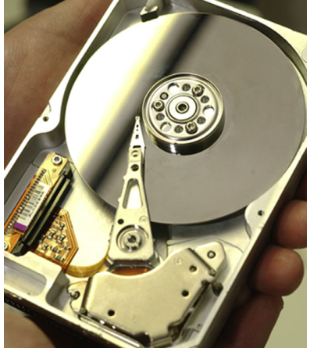
Cont…

Slide 11
COMPUTING ENVIRONMENTS
Desktop
Cloud Computing
Infrastructure as a Service (IaaS), Platform as a Service (PaaS), and Software as a Service (SaaS).

Slide 12
FILE SYSTEMS
File Allocation Table (FAT) FAT12, FAT16, FAT32
The New Technology File System (NTFS)
Ext3 and Ext4

Slide 13
Virtual memory (Swap partition)

Slide 14
Labs and Tools
Virtual Labs (Considerations) 1. Security—The security of the system must be robust enough to maintain the level of evidence integrity required by the courts. Otherwise there could be catastrophic consequences, such as rendering evidence from multiple cases inadmissible. 2. Performance—For this scheme to work, connectivity must be both speedy and reliable. No connection or a slow connection will quickly impact the organization’s ability to function. 3. Cost—Startup costs in particular are substantial and potentially beyond what many agencies can afford (Whitcomb)

Slide 15
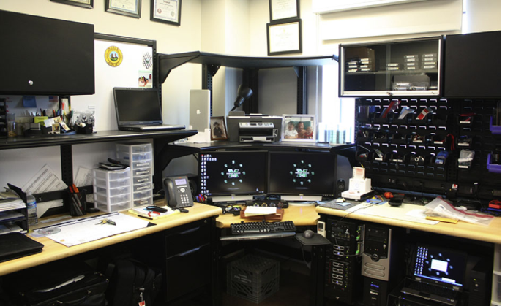
Tools

Slide 16
Windows System Artifacts
DELETED DATA The deleted data will remain until another file is written over it. This can take quite some time, if it’s done at all.
Modes
Hibernation
Sleep

Slide 17
REGISTRY
The Windows Registry plays a crucial role in the operation of a PC. Microsoft’s TechNet defines the registry as “simply a database for configuration files.”
You could also describe it as the computer’s central nervous system. In that context, you can see just how critical the registry is to the Windows computer.

Slide 18
Registry Structure
The registry is set up in a tree structure similar to the directories, folders, and files you’re used to working with in Windows. The registry is broken into four tiers or levels.
Two of the major multipurpose forensic tools, EnCase and FTK, do just that.

Slide 19
First investigation
Print spooling
Recycle bin
Metadata
Removing metadata
Thumbnail cache

Slide 20
Anti forensics
Hiding data
Encryption
Bitlockers
Cipher text
Simple encryption
Algorithms
Triple DES
RSA
AES

Slide 21
Presentations
RSA
SSL
Hashing
Steganography

Slide 22
End of lecture

